Slide 1
Central Valley Flood Protection Board Update
August 28, 2015
Presented by:
Michael Mierzwa, P.E.
Michael.Mierzwa@water.ca.gov
Lead Flood Management Planner
California Department of Water Resources

Slide 2
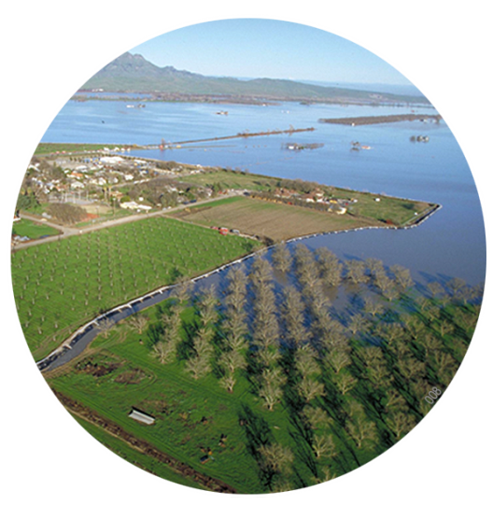
Today’s Discussion
Where We’ve Been
- CVFPP Public Workshop Summary
Where We Are
- Hydrologic Variability/Climate Change Approach
Where We're Going
- Regional Flood Management Plan Integration

Slide 3
Where We’ve Been
CVFPP Public Workshop Summary

Slide 4
CVFPP Public Workshop Summary
Key comments
Workshop summary now available: www.water.ca.gov/cvfmp
Review past presentations:
www.water.ca.gov/cvfmp/meetings

Slide 5
Where We Are
Hydrologic Variability /
Climate Change Considerations for 2017 CVFPP Update

Slide 6
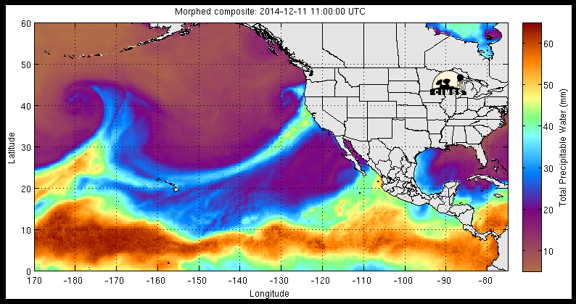
Hydrologic Variability Considerations
Notes:
Potential impacts of future climate change must be considered in the 2017 update to the CVFPP.
Today I’ll walk you through our approach to looking at potential climate change impacts and how science is informing the planning process.
If you weren’t at the Climate Change Symposium last month at UC Davis, I encourage you to go online to download the presentations. Amy Bindra gave a presentation similar to the one I’ll be covering today, and I also spoke about hydrologic variability as one of several key considerations in managing complex water management systems.

Slide 7
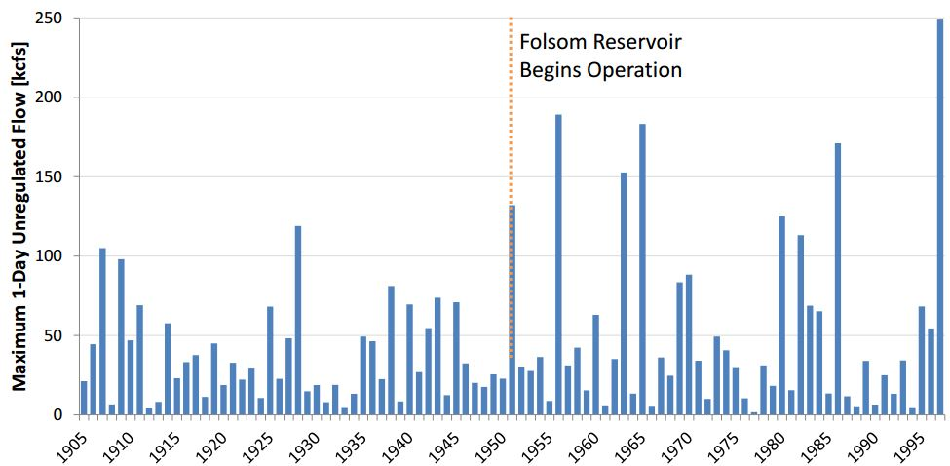
Hydrologic Variability Considerations: American River Example
American River at Fair Oaks
Water Year
Source: Sacramento and San Joaquin Comprehensive Study

Slide 8
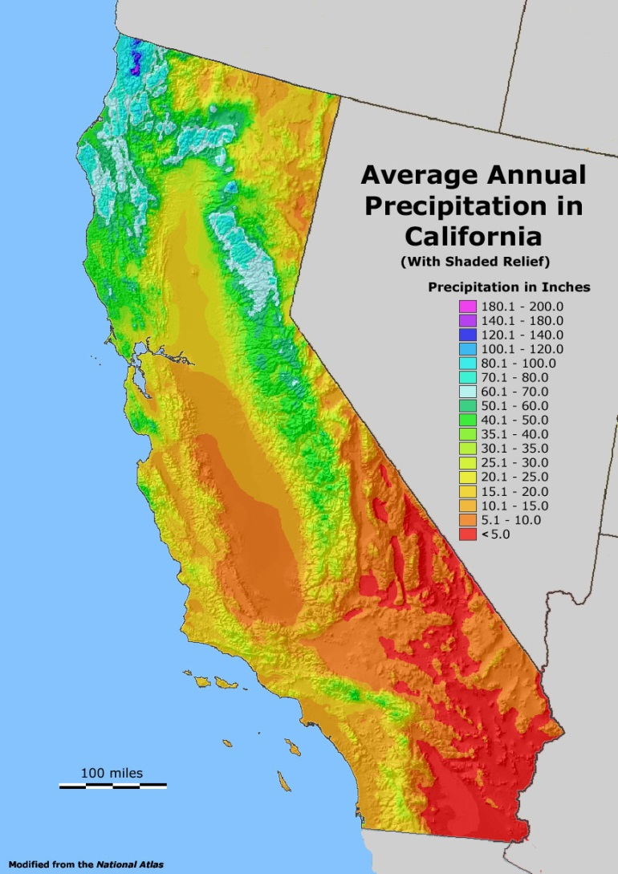
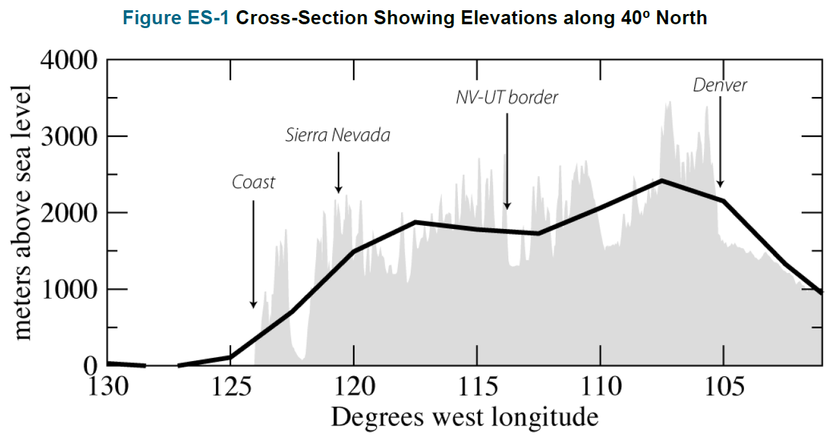
Importance of Sierra Nevada Range in CA Water Management

Slide 9
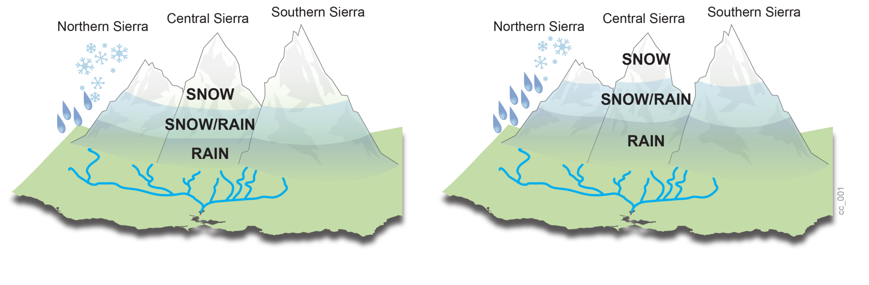
How Temperature Increases Influence Storm Runoff Volumes
CONCEPT GRAPHIC
Existing Rain / Snow Trends
Future Rain / Snow Trends

Slide 10

How Sea Level Rise Influences System Outflow
Estimates of Future Sea Level Rise in California
 | Low | Mean | High
2030 | 4.3 cm | 14.4 cm | 29.7 cm
2050 | 12.3 cm | 28.0 cm | 60.8 cm
2062* | 18.5 cm (0.61 ft.) | 38.8 cm (1.27 ft.) | 83.1 cm (2.73 ft.)
2100 | 42.4 cm | 91.9 cm | 166.4 cm
(Source: NRC, 2012)

Slide 11
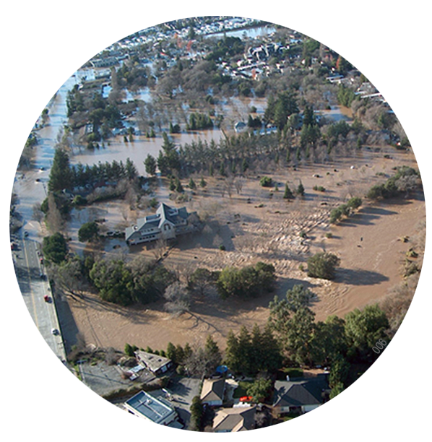
Climate Change Impacts
Contributes to rise in extreme weather events
Expected to generate more extreme floods, more seasonal rain, less snow and rising sea levels
Increases stress on the system
Notes:
The Central Valley has historically remained vulnerable to flood hazards.
Even after effective investment, our flood risk remains high and flood risk will increase under the impact of stressors like climate change, aging infrastructure, development in flood prone zones and population growth.
Climate change in particular is projected to bring in more frequent and severer weather events and thus more extreme flood flows which will put unprecedented stress on the Central Valley's flood management system.

Slide 12
Climate Change Approach for 2017 CVFPP
Multi-phased approach
Uses latest science and data
Integrates existing hydrologic and flood risk approaches
Consistent with State’s climate change policies
Notes:
CVFPP approach: Linking atmospheric processes, precipitation and temperature fields, and watershed conditions to inform changes in flood risk.

Slide 13
Refinement Using a Multi-Phased Approach
Phase 1 – included in 2012 plan
Phase 2a – 2007 global climate models, 112 independent climate projections
Phase 2b – More robust analysis and integration; 2013 global climate models, 200 independent climate projections
Notes:
Climate science is evolving. The science is relatively young and with each year or each five years, we tend to get greater and improved information.
We are now in phase 2, updating the latest set of climate projections. Part of this also includes coordinating, reviewing and integrating existing and on-going DWR-supported
climate science research:
– Atmospheric River Study (SIO)
– Watershed Sensitivity Study (UCD)
– Central Valley Sensitivity Study (USACE)

Slide 14
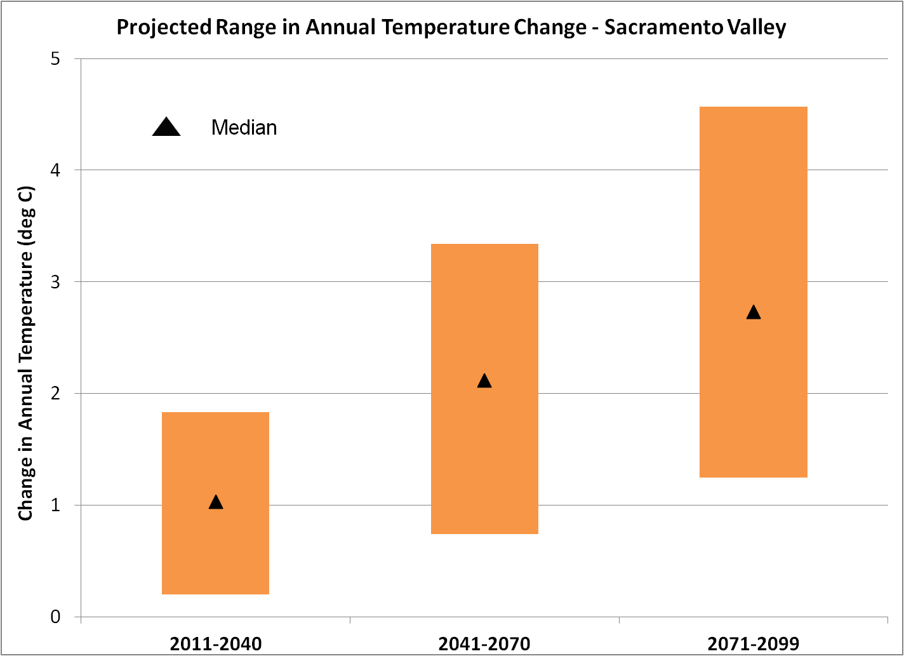
Increasing Temperatures
Notes:
On this graph you’ll see that temperatures are increasing and are projected to continue to increase.
The bar on the left looks at 2011-2014, which we’re calling near-term.
The center bar is 2041-2070, which we’re calling mid-Century.
And the bar on the right is late-Century, 2071-2099.
We have seen warming over the past 50 years and considerable warming over the last 30 years.

Slide 15
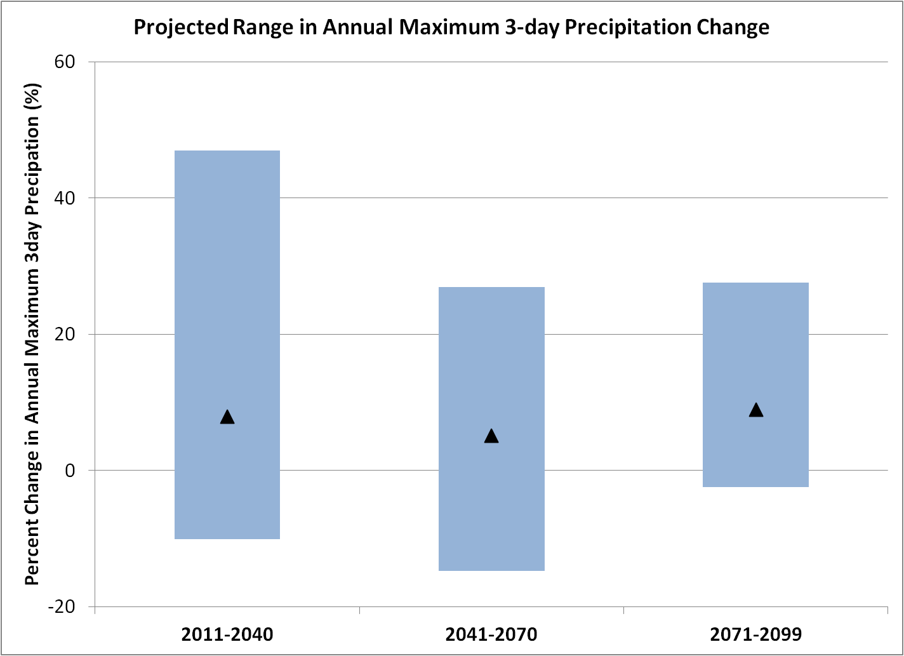
Increasing Precipitation Extremes
Notes:
We are seeing changes in precipitation as well – we are likely to see higher extremes.
Again, from left to right we’re looking at near-term, mid-century and late-century.

Slide 16
Consistency w/ State Climate Planning Efforts

Slide 17
Consistency w/ State Climate Planning Efforts

Slide 18
How Temperature Increases Influence Storm Runoff Volumes
CONCEPT GRAPHIC
Existing Rain / Snow Trends
Future Rain / Snow Trends

Slide 19
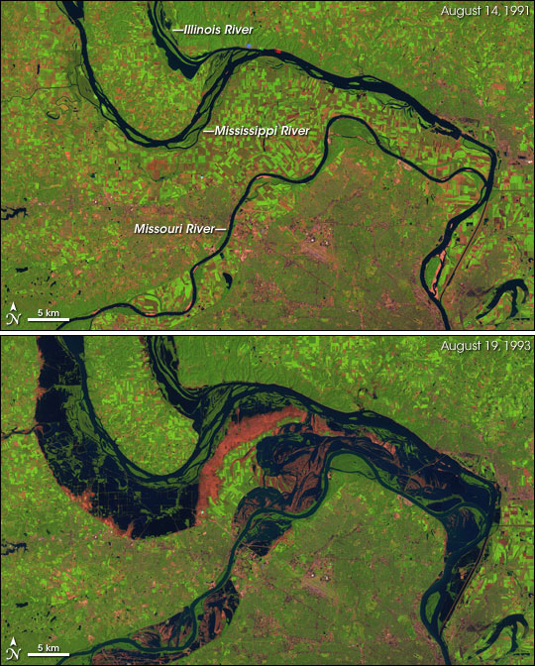
Rise & Fall of Rivers: Mississippi River Basin Concept
Satellite imagery of the confluence of the Missouri and Mississippi Rivers north of St. Louis, Missouri.
Seasonal vs. Inter-annual Differences – Flow & Physical Footprint
Floodplains Near Rivers Can Actually Be Higher Elevation than Flood Terraces

Slide 20
Attaining a Resilient System
Goal is a resilient flood management system that:
  Functions effectively over a long period
  Can recover from large flood events
  Addresses hydrologic variability climate change
Balanced
Reasonable
Cost-efficient
Notes:
Flood management infrastructure and policy decisions will likely be tested against climate variability and change not experienced in the past 100 years.
Our systems need to be resilient to accommodate a range of hydroclimatic futures.

Slide 21
Where We’re Going
Regional Flood Management Plan Integration

Slide 22
Regional Flood Management Plan Integration
RFMPs contain strong baseline dataset needed to build diverse portfolios of management actions.
Working with regions to refine management actions, build portfolios to accomplish CVFPP goals and intended outcomes
Taking advantage of the regions’ hard work
  Will be reflected in 2017 CVFPP Update
  Shaping how the State articulates value of collective investments and need for sustainable funding solutions

Slide 23
Central Valley Flood Protection Board Update
August 28, 2015
Presented by:
Michael Mierzwa, P.E.
Michael.Mierzwa@water.ca.gov
Lead Flood Management Planner
California Department of Water Resources

